Slide 1
Restricted Boltzmann Machine

Slide 2
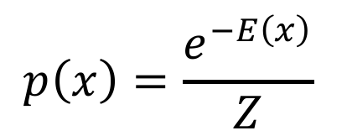
Energy-based models
$$p\left(x\right)=\frac{e^{−E\left(x\right)}}{Z}$$
Intuitively (or exactly) speaking, the probability of a certain state is inversely proportional to its energy.
This probability distribution is often called a Boltzmann distribution.
This is where the name restricted Boltzmann machine comes from.

Slide 3
Boltzmann machine
A Boltzmann machine is a network whose elements consist of 0 and 1 (binary units).

Slide 4
Restricted Boltzmann Machine
A restricted Boltzmann machine restricts connections between visible and hidden nodes.

Slide 5
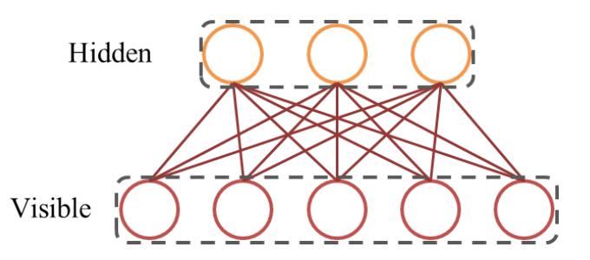
Restricted Boltzmann Machine

Slide 6
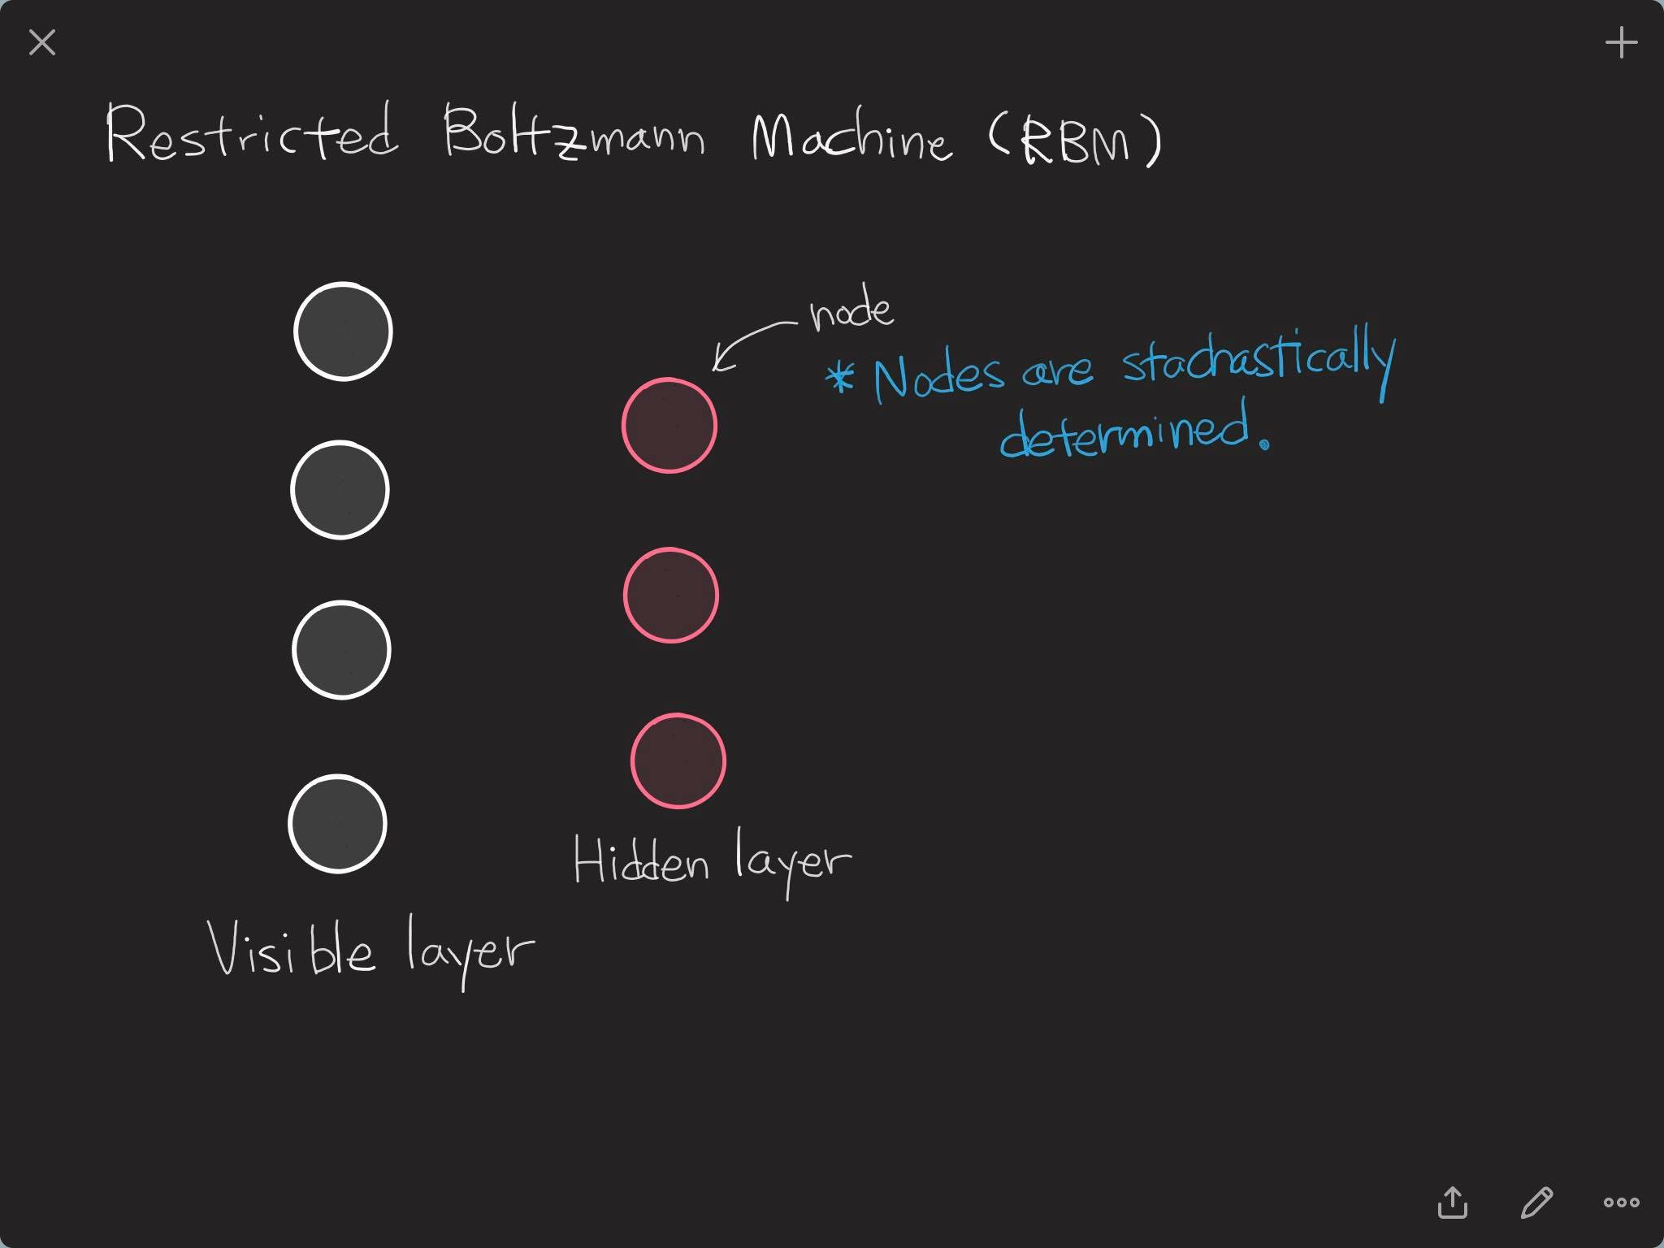

Slide 7
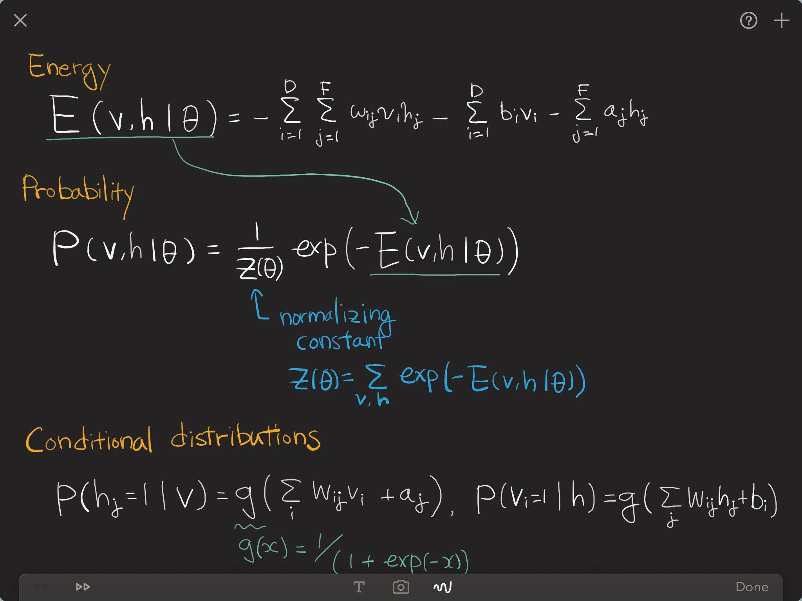

Slide 8
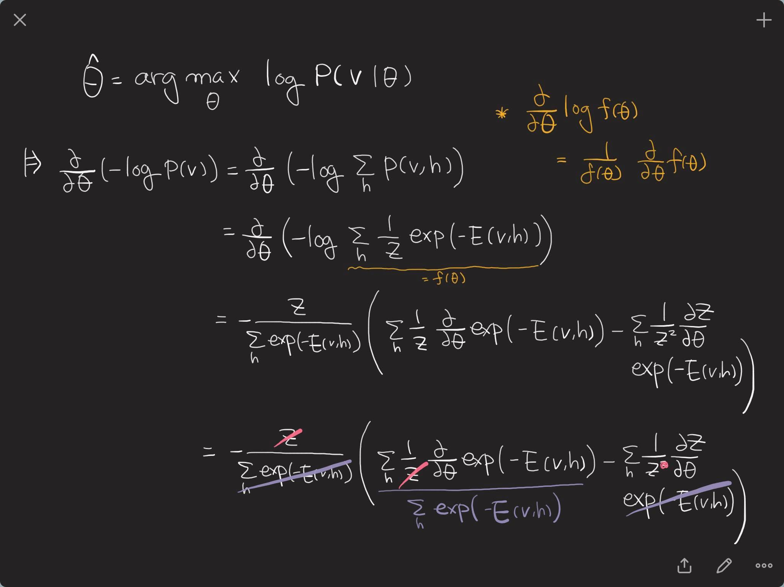
sum rule

Slide 9
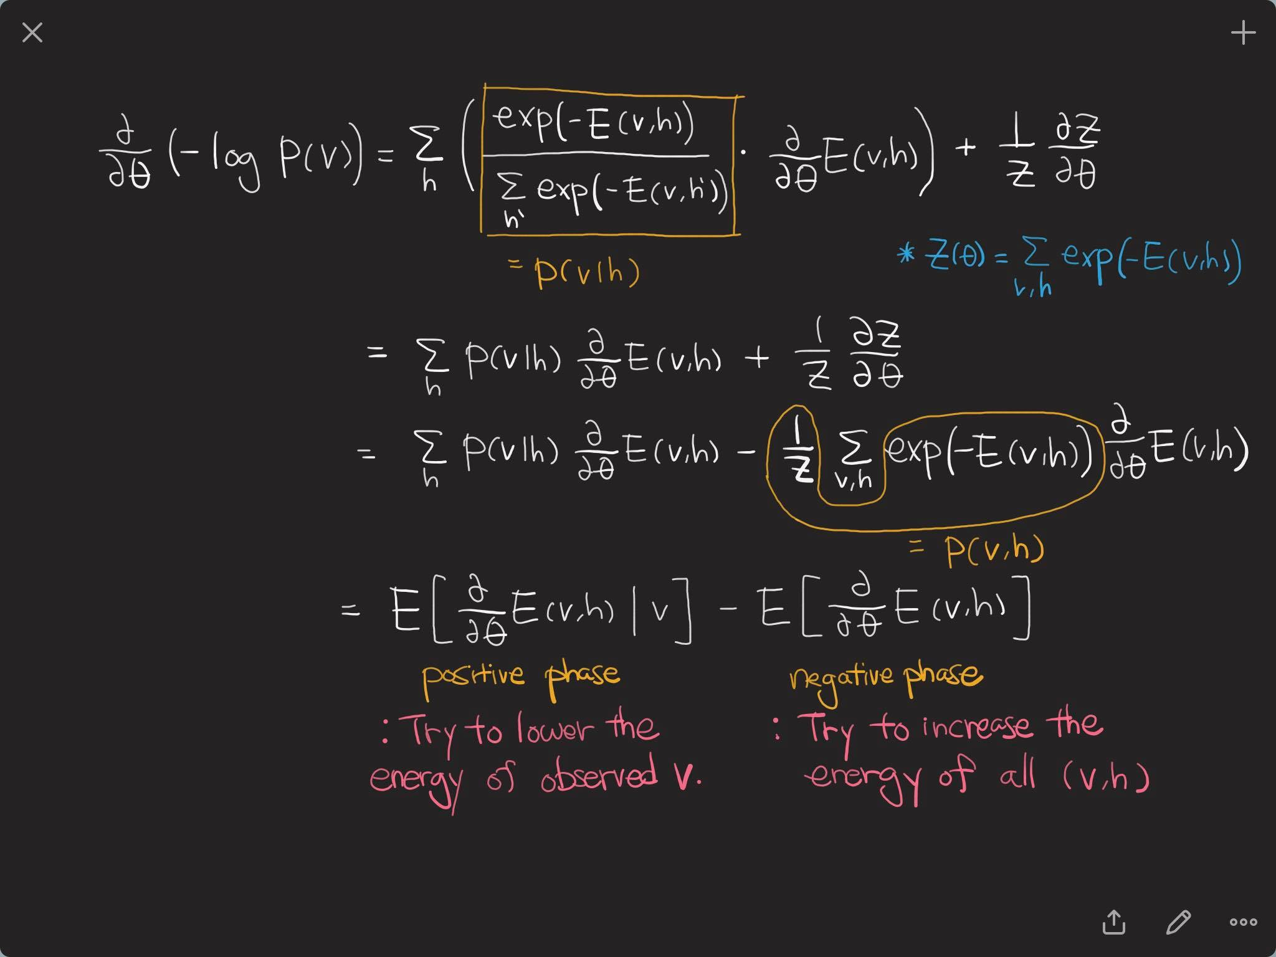

Slide 10
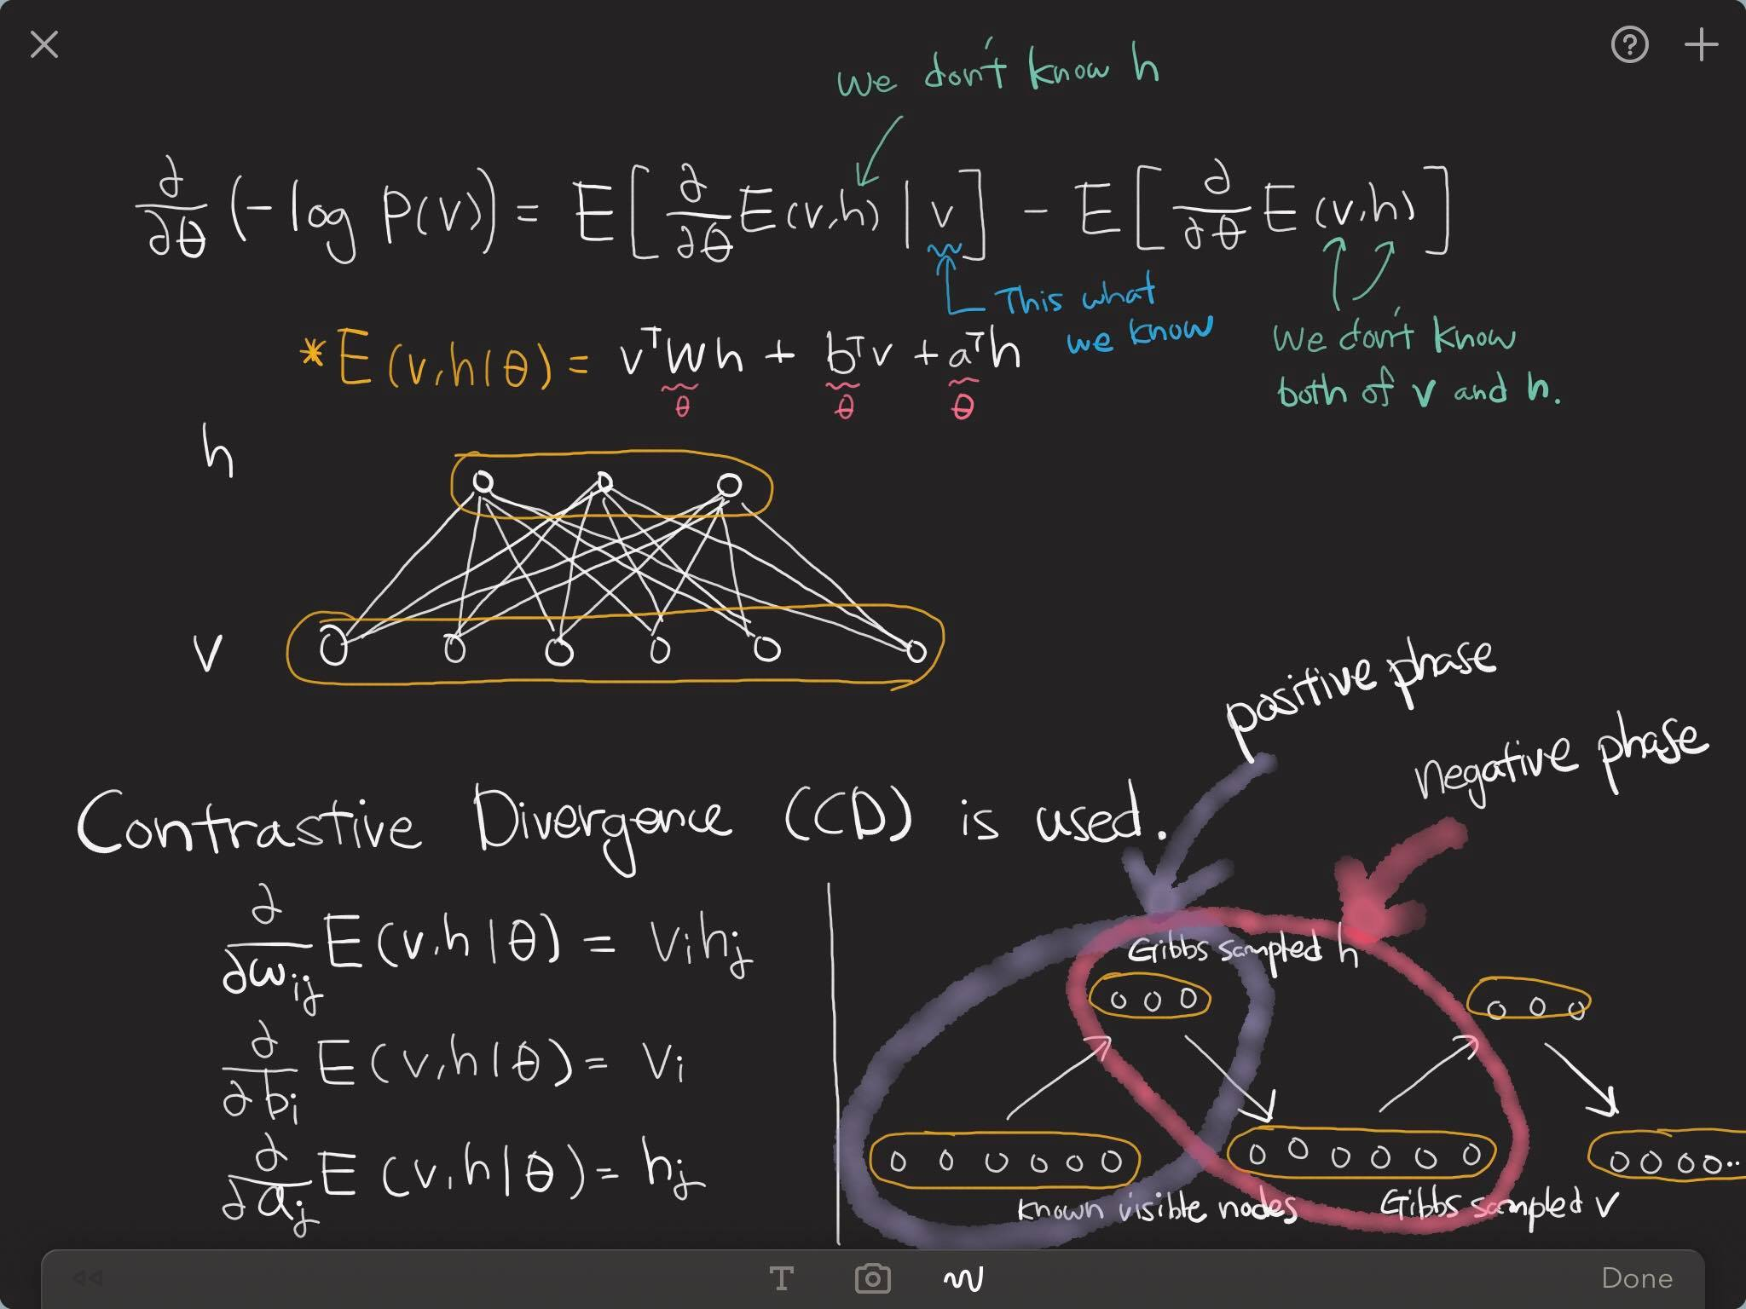

Slide 11
Deep Belief Network (DBN)
A DBN simply stacks RBM, level by level.
Training is done in a layer-wise manner.
It is an unsupervised learning method.
DBN had been widely used as a pre-training method until 2014..

Slide 12
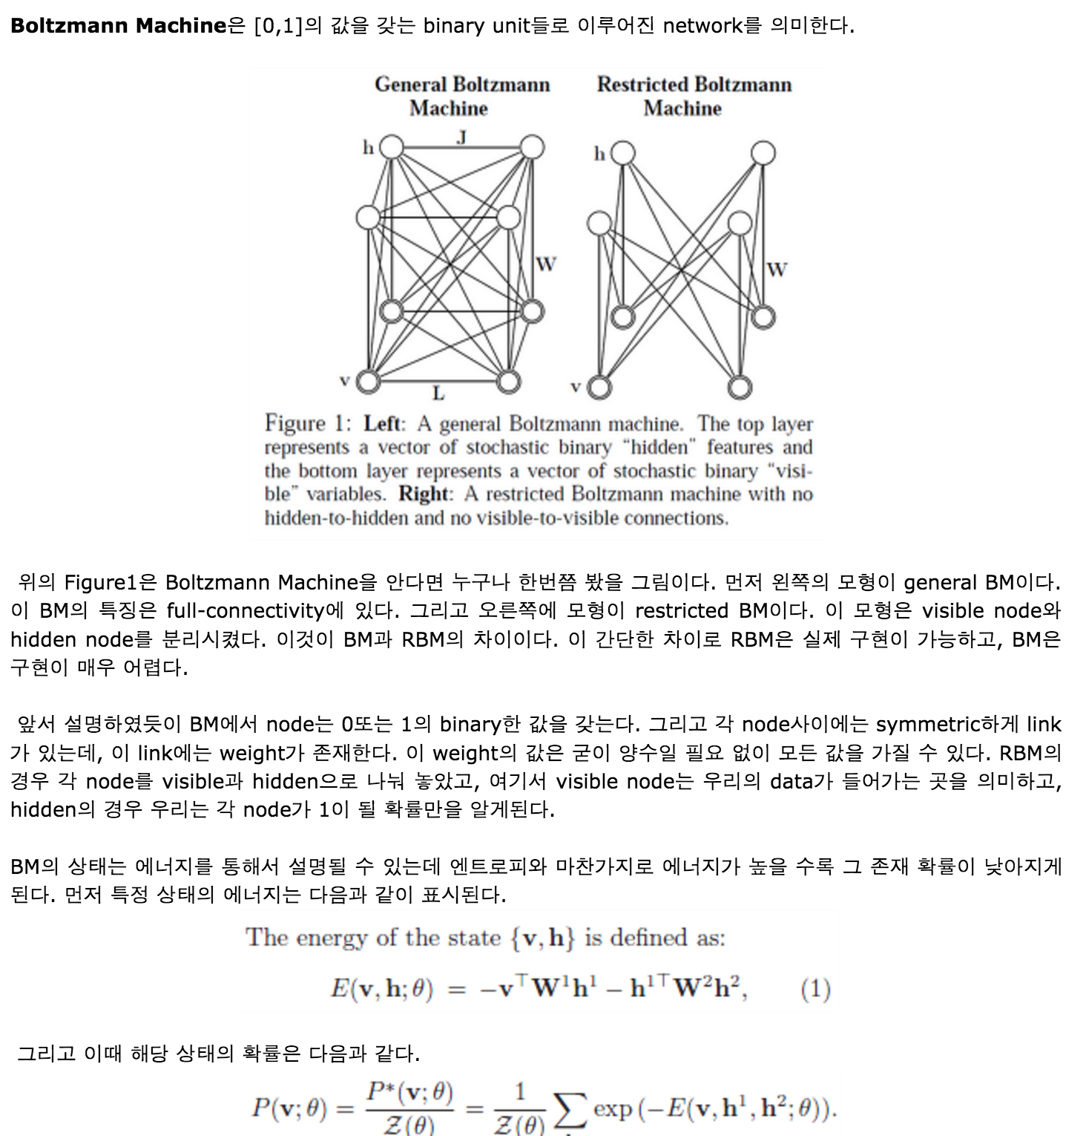
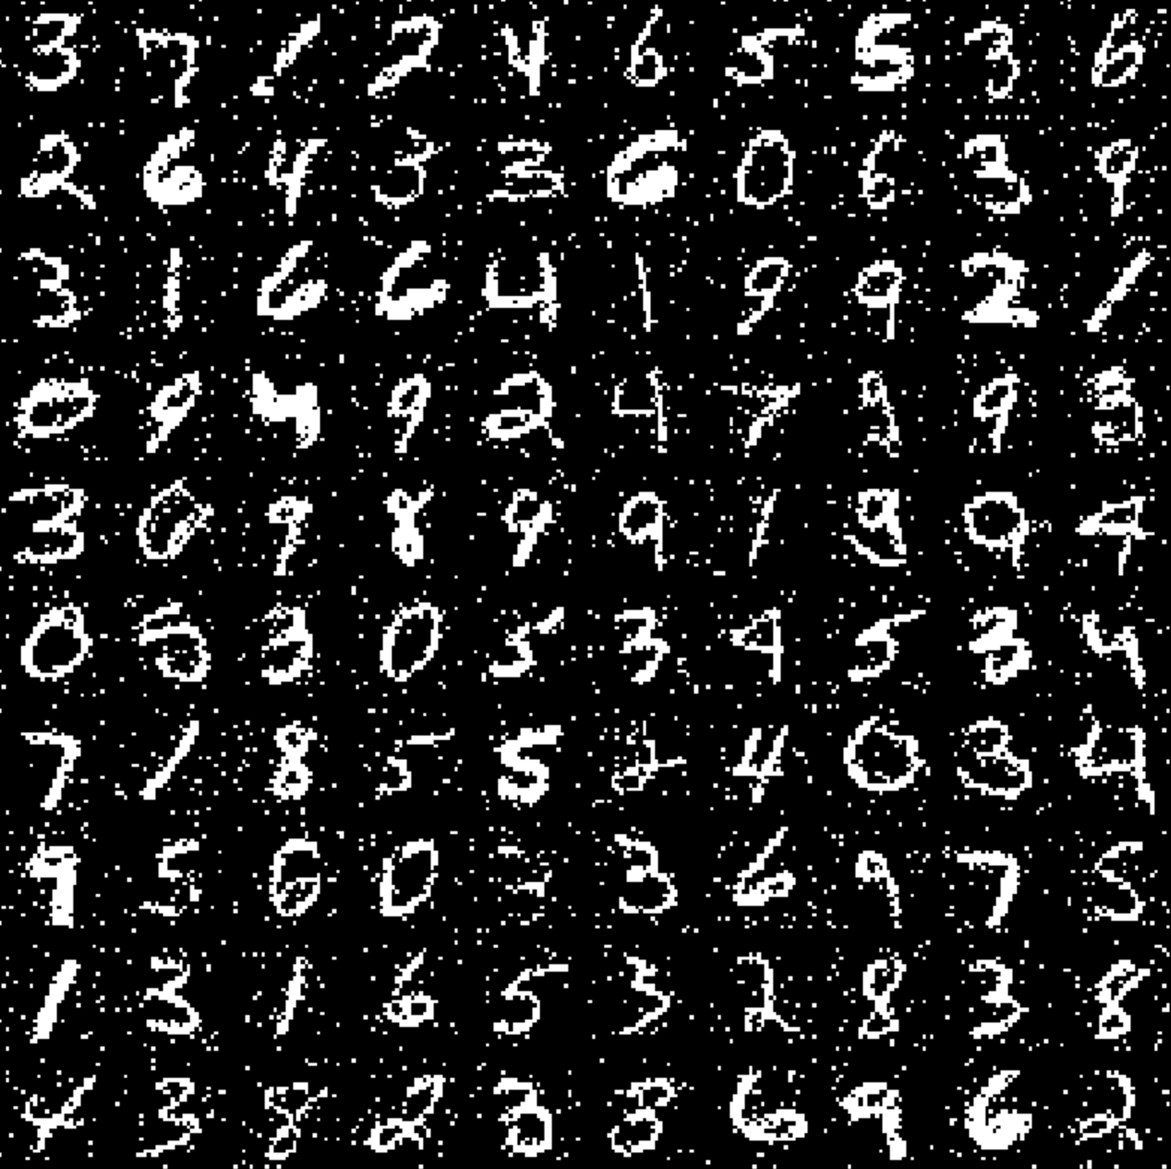
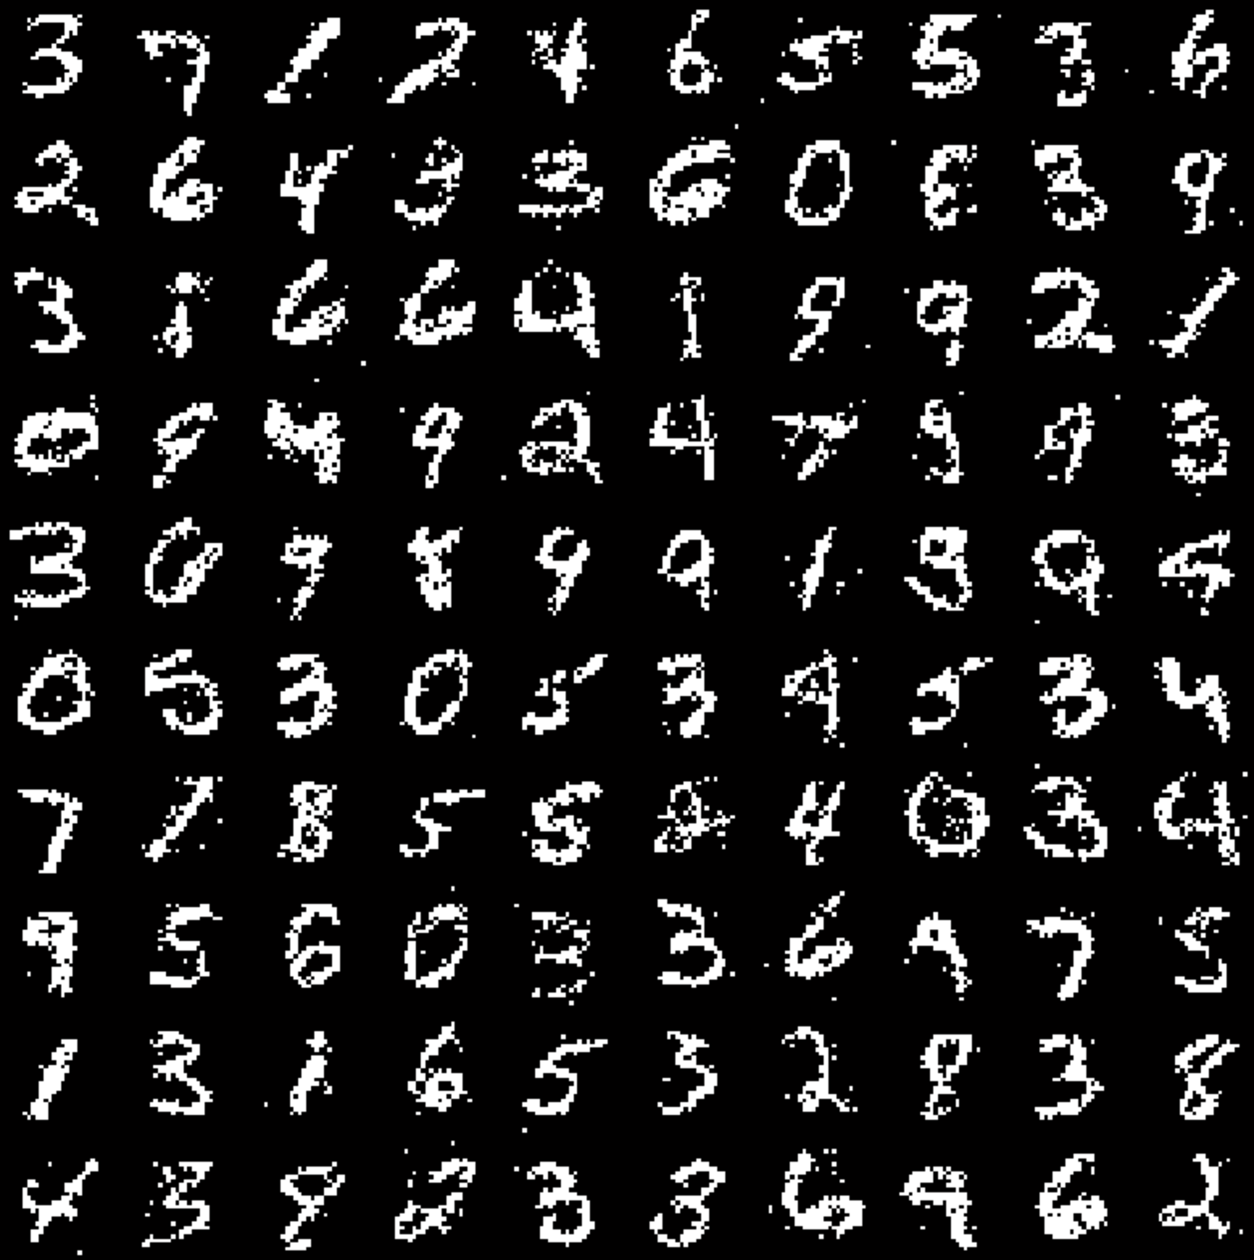
More information
http://enginius.tistory.com/315

Slide 13
Applications

Slide 14
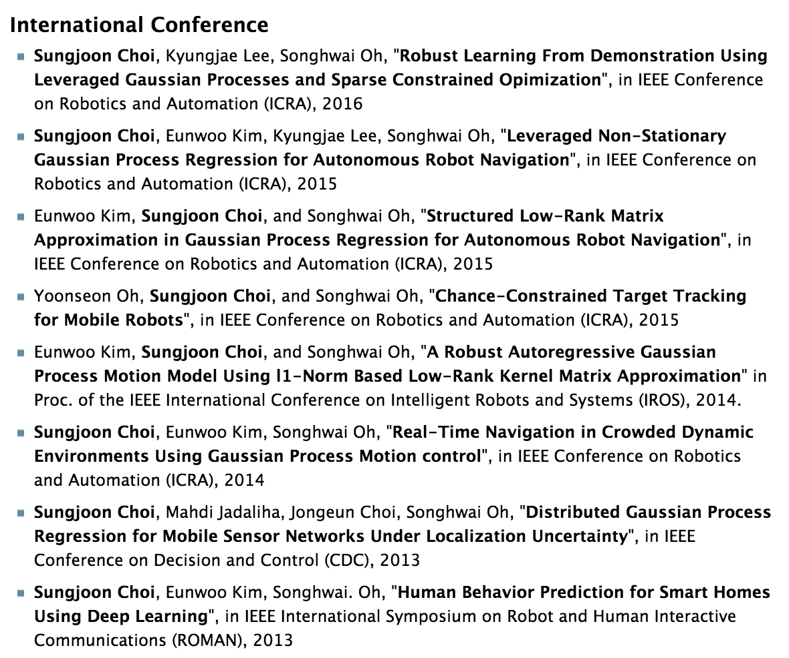
My first conference paper
Sungjoon Choi, Eunwoo Kim, Songhwai Oh, “Human Behavior Prediction for Smart Homes Using Deep Leering”, ROMAN, 2013

Slide 15
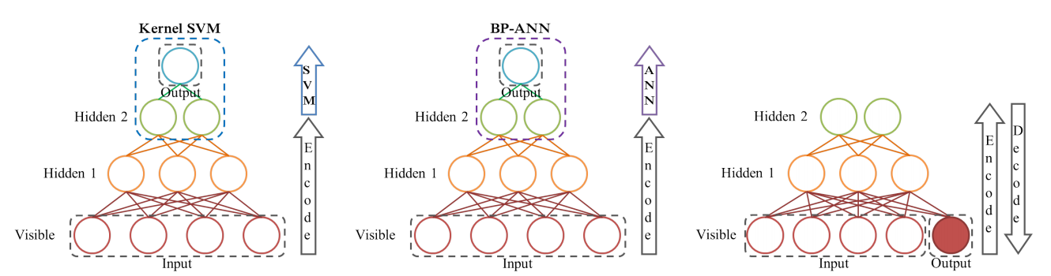
DBN-Reconstruct

Slide 16
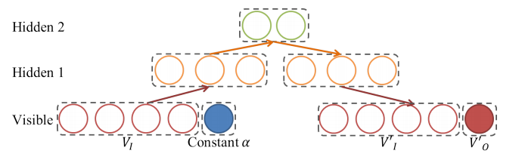
DBN-Reconstruct

Slide 17
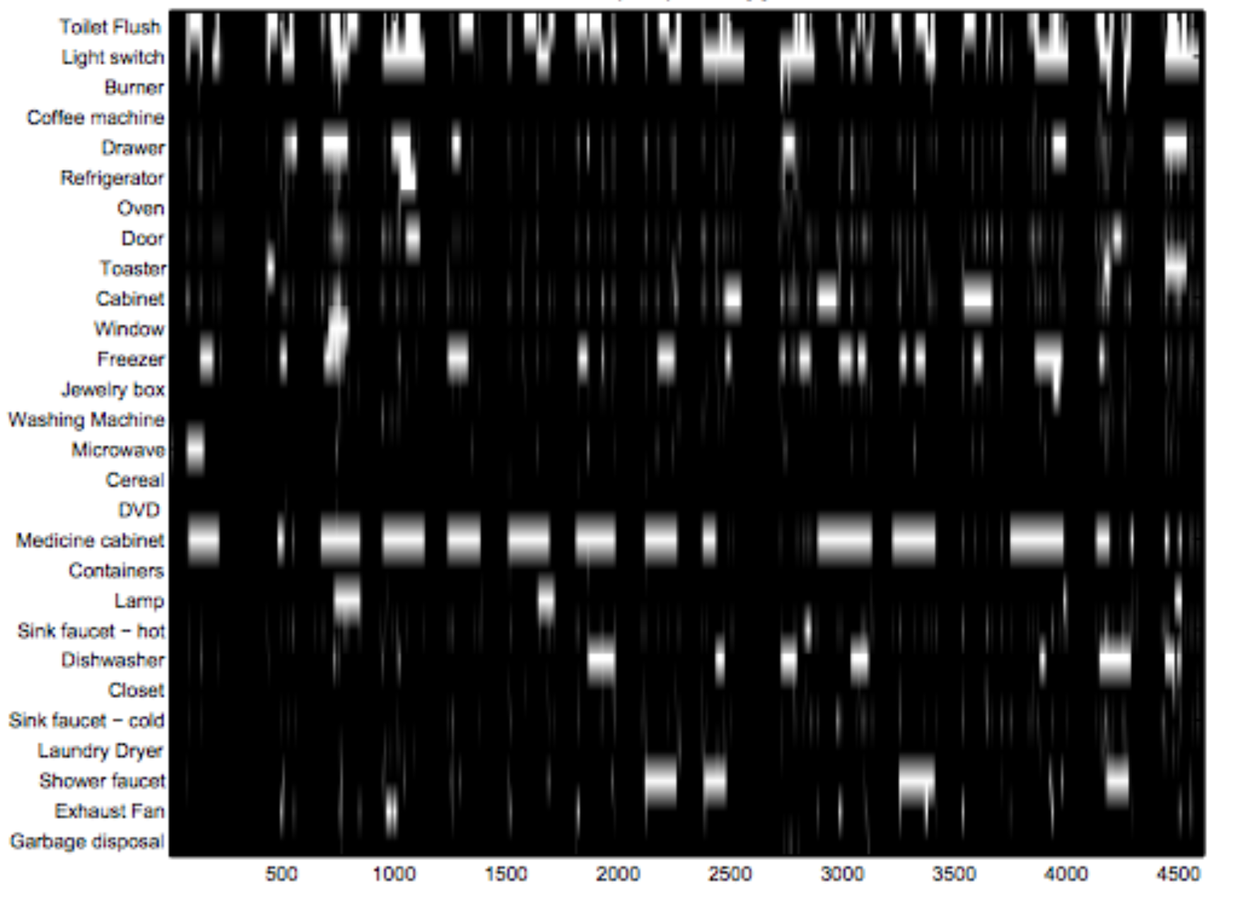
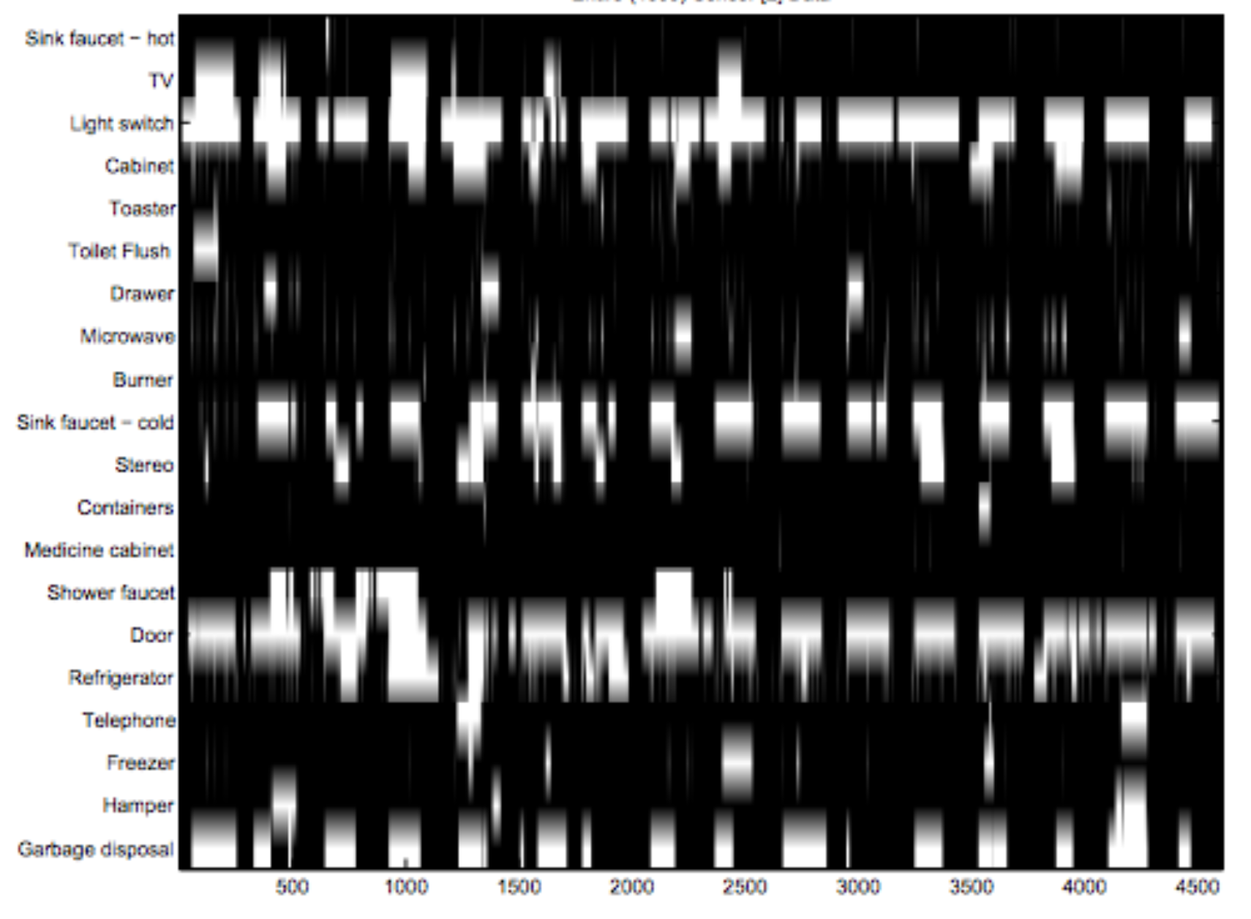
Use to predict Home Dataset

Slide 18
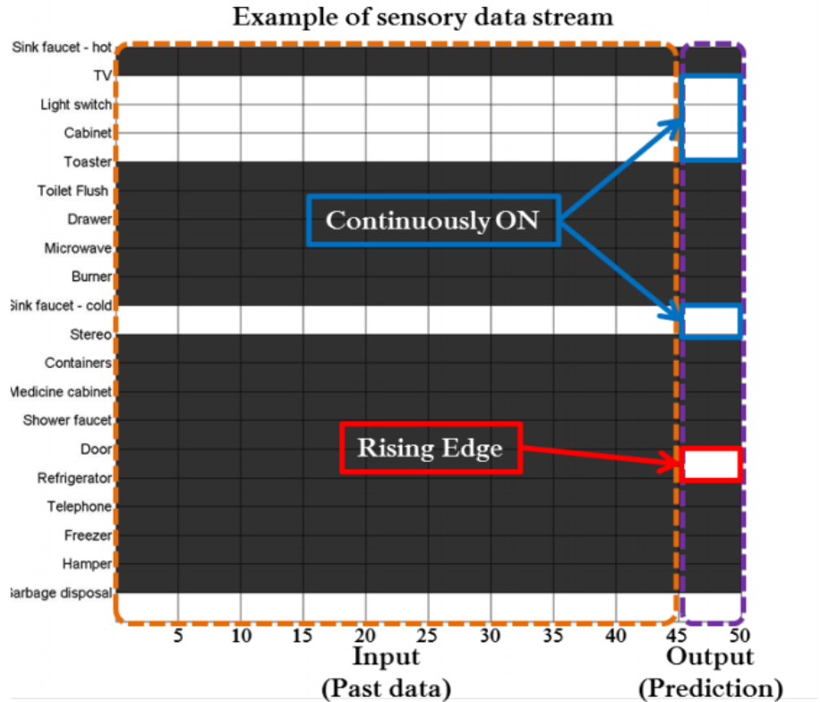
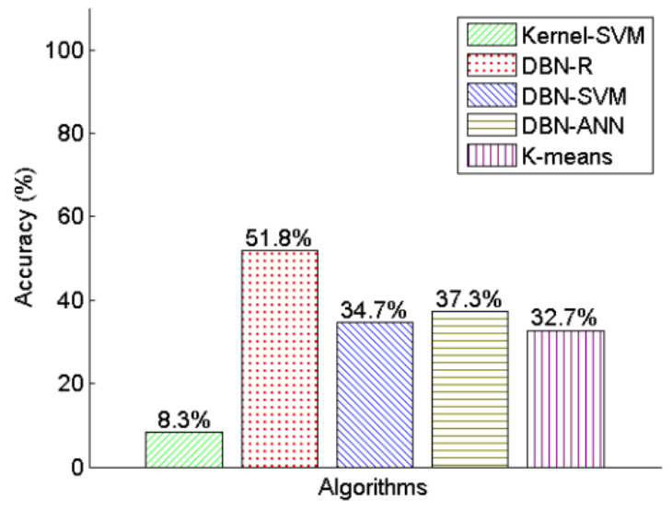
Result

Slide 19
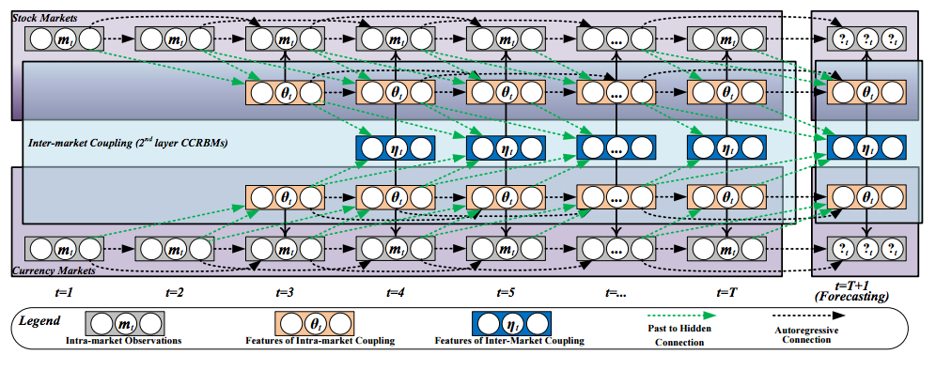
Finance forecasting

Slide 20
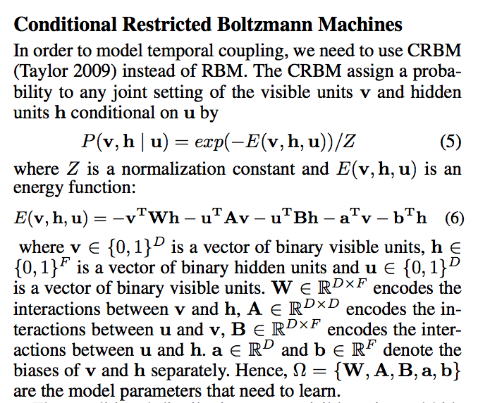
Conditional RBM

